Slide 1
A Review of
Probability Models
Dr. Jason Merrick
Notes:
Last update August 20, 1998

Slide 2
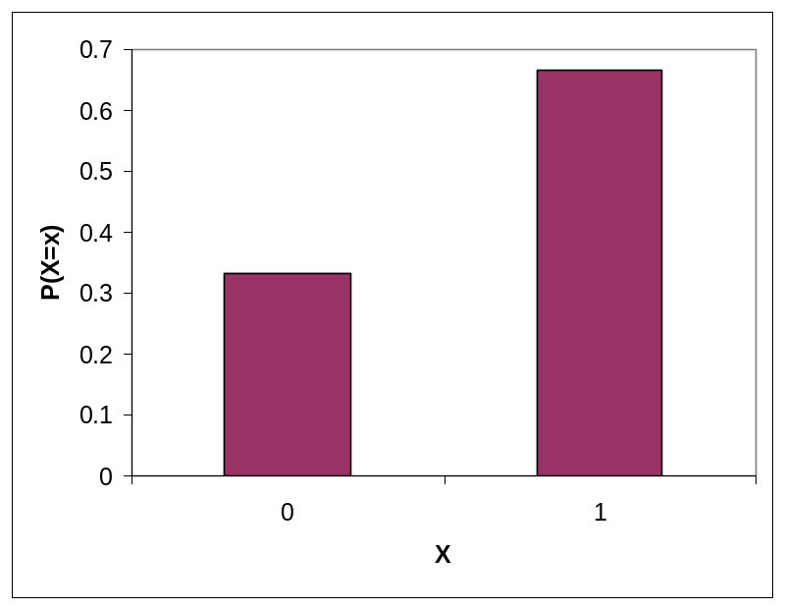
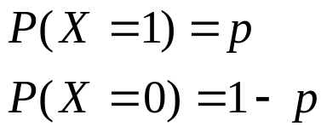


Bernoulli Distribution
The simplest form of random variable.
  Success/Failure
  Heads/Tails

Slide 3
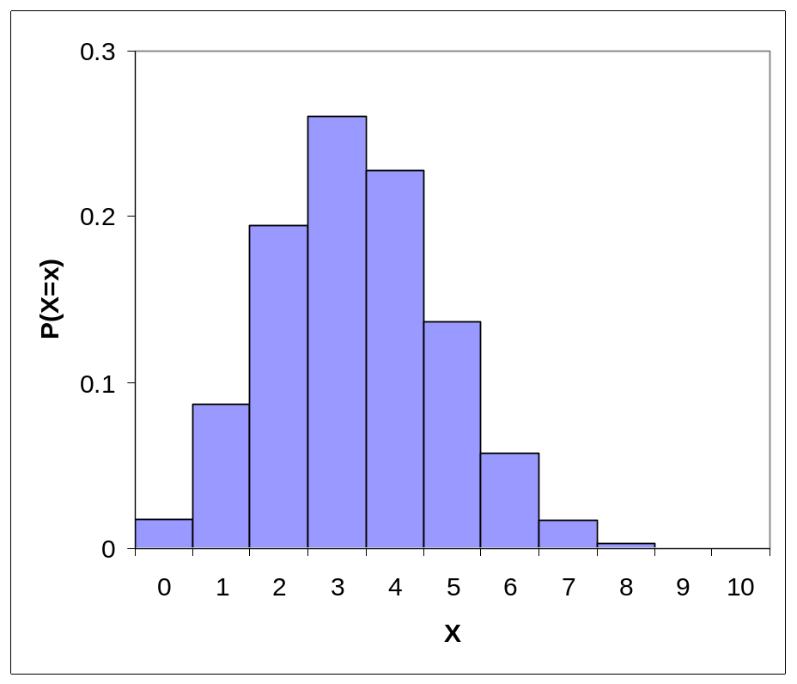
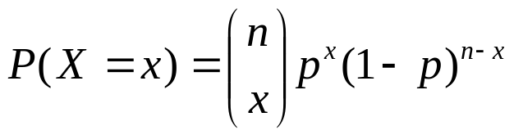


Binomial Distribution
The number of successes in n Bernoulli trials.
  Or the sum of n Bernoulli random variables.

Slide 4
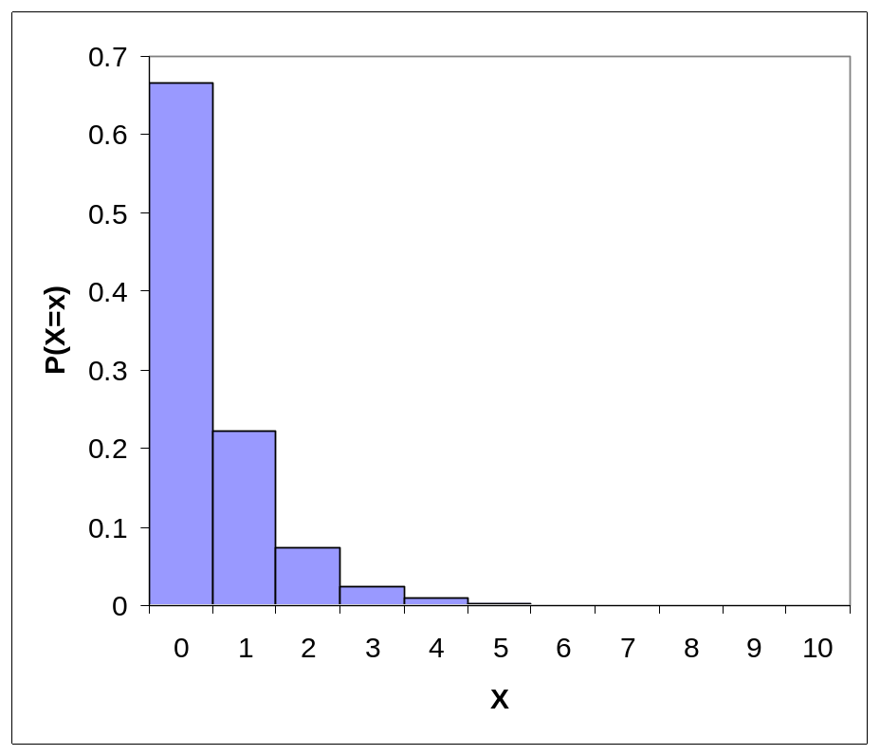

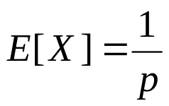
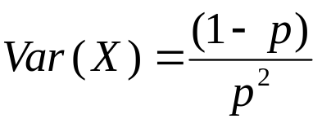
Geometric Distribution
The number of Bernoulli trials required to get the first success.

Slide 5
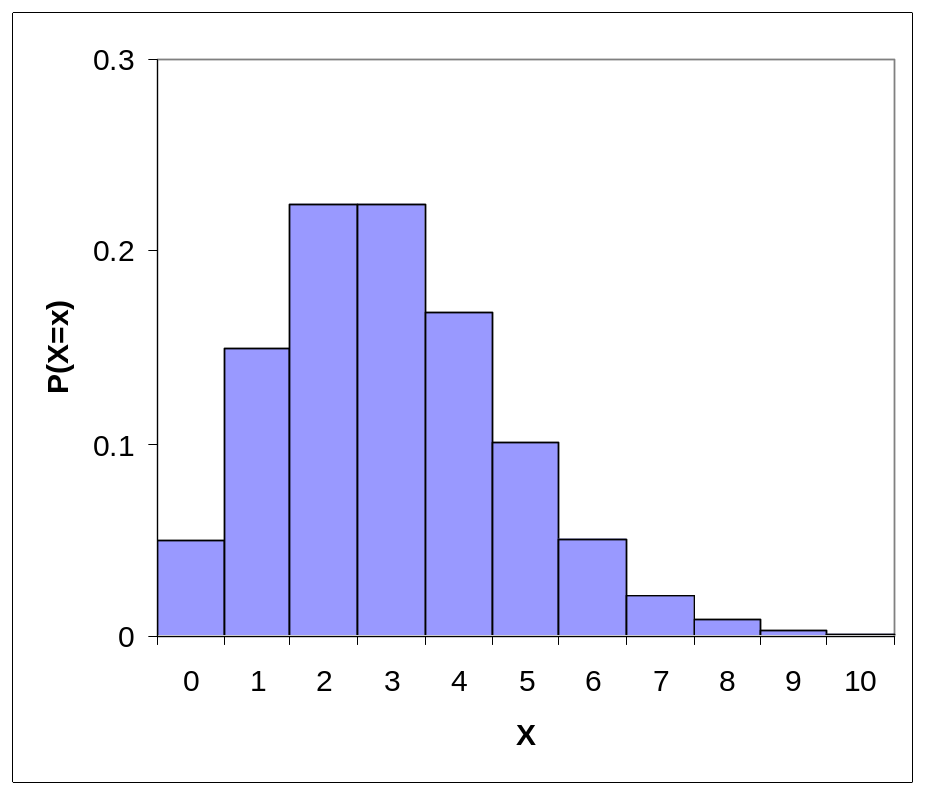
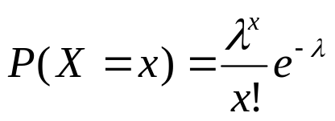


Poisson Distribution
The number of random events occurring in a fixed interval of time
  Random batch sizes
  Number of defects on an area of material

Slide 6
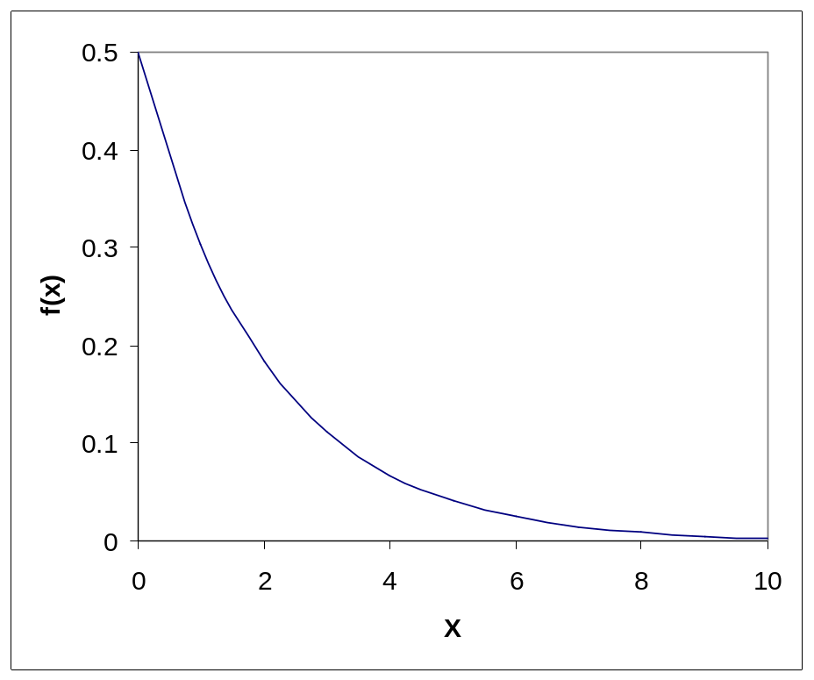
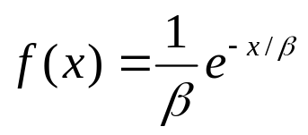



Exponential Distribution
Model times between events
  Times between arrivals
  Times between failures
  Times to repair
  Service Times
Memoryless

Slide 7
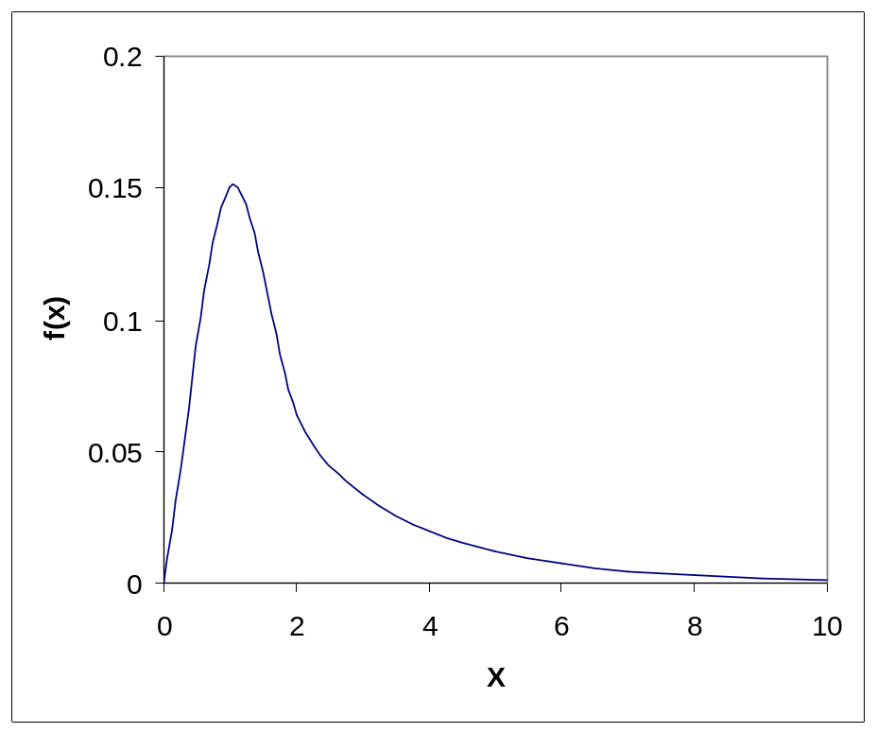
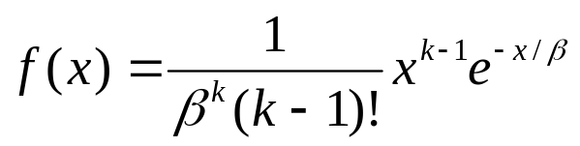


Erlang Distribution
The sum of k exponential random variables
Gives more flexibility than exponential

Slide 8
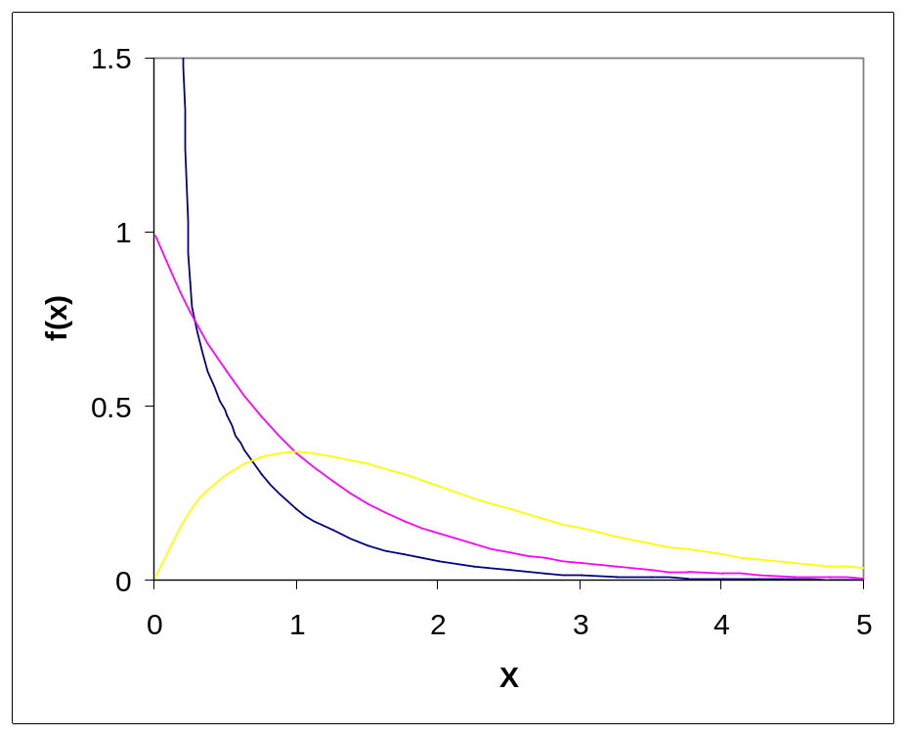
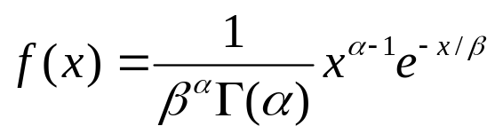





Gamma Distribution
A generalization of the Erlang distribution, μ is not required to be integer
More flexible
Has exponential tail

Slide 9
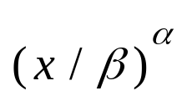
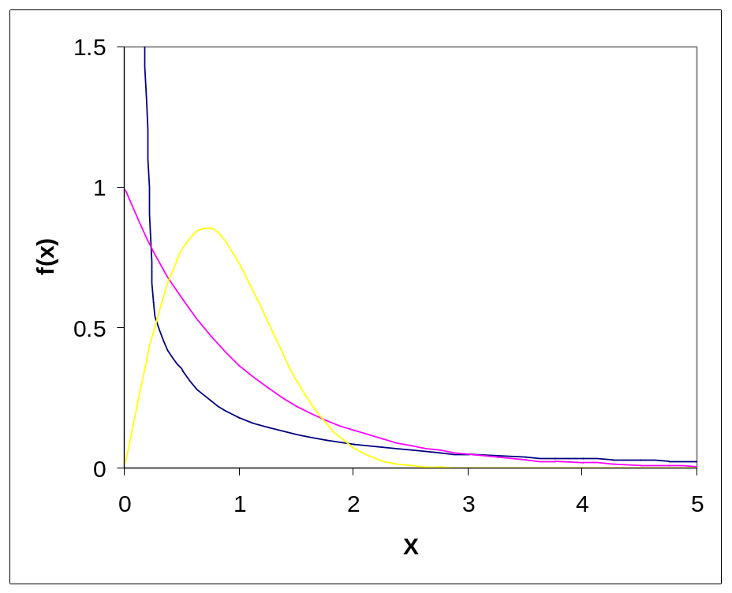
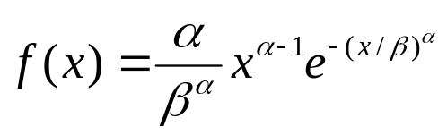
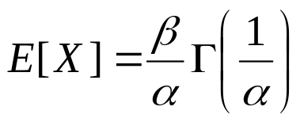
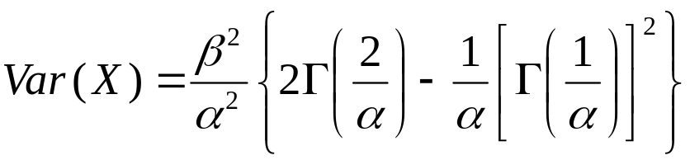
Weibull Distribution
Commonly used in reliability analysis
The rate of failures is

Slide 10
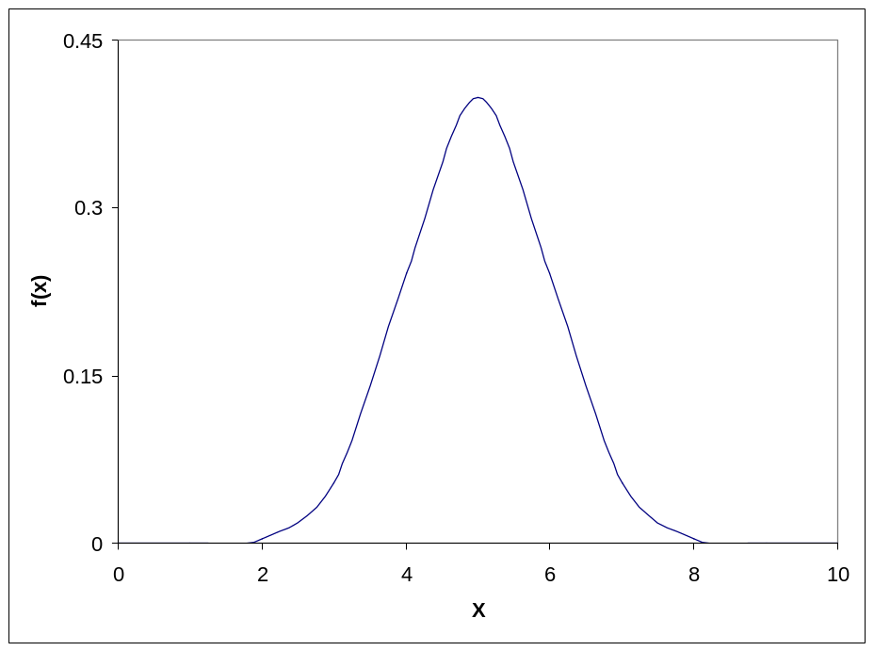
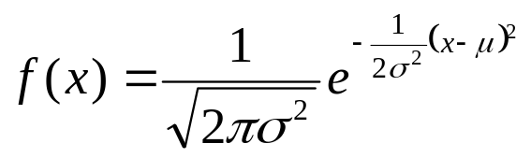


Normal Distribution
The distribution of the average of iid random variables are eventually normal
Central Limit Theorem

Slide 11
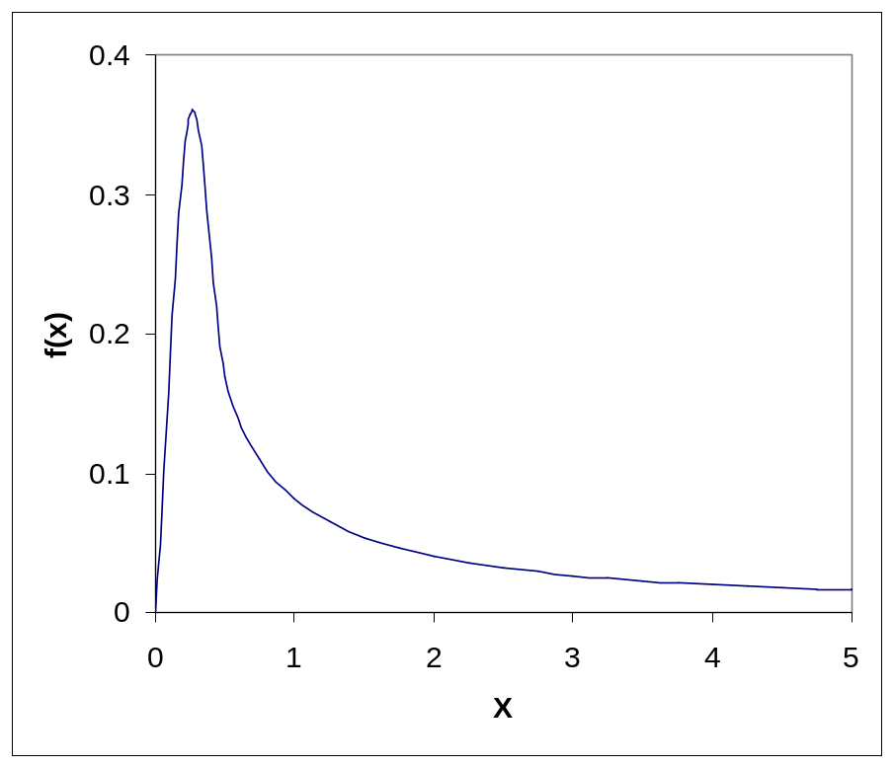
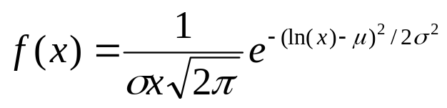


Log-Normal Distribution
Ln(X) is normally distributed.
  Used to model quantities that are the product of a large number of random quantities
  Highly skewed to the right.

Slide 12
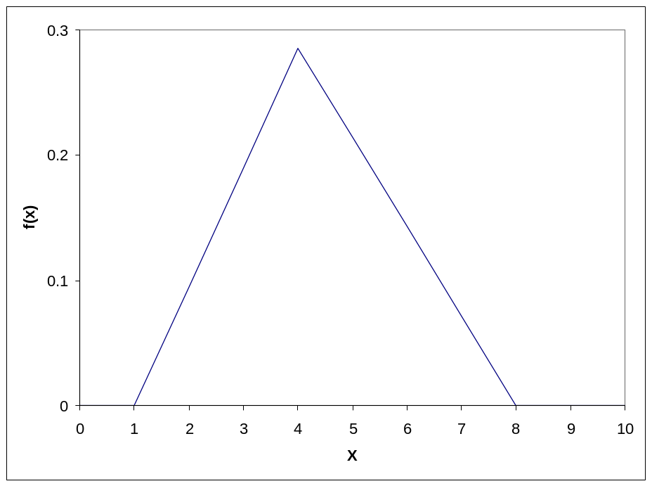
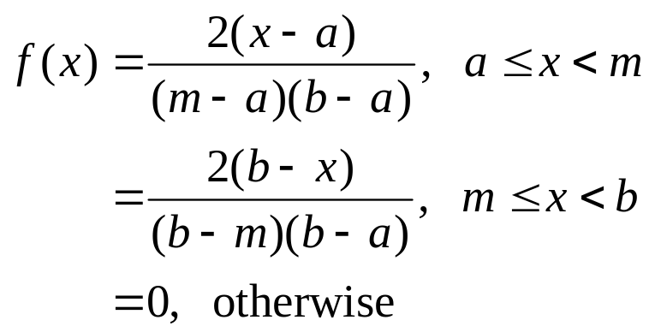


Triangular Distribution
Used in situations were there is little or no data.
  Just requires the minimum, maximum and most likely value.

Slide 13
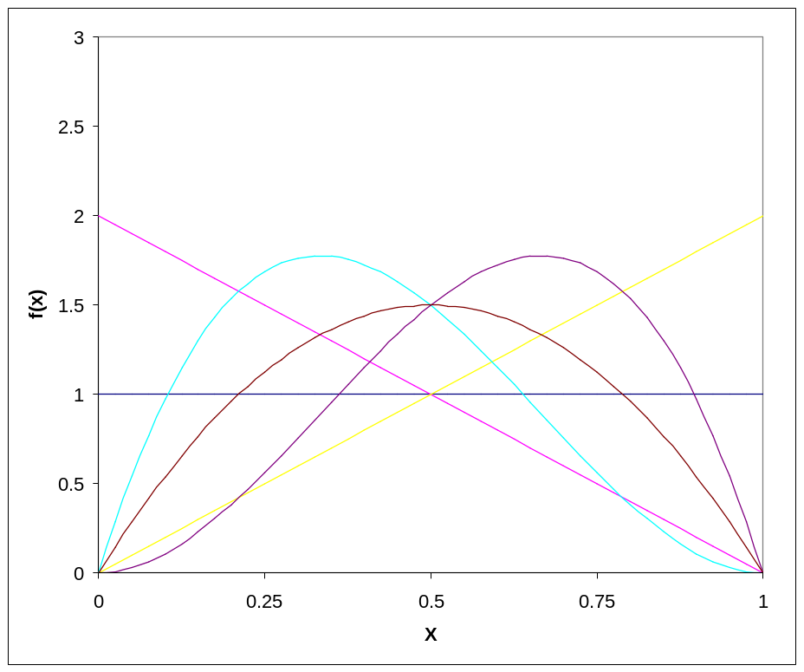
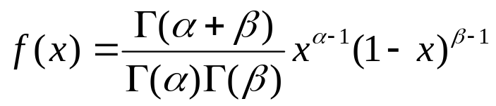
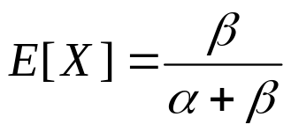
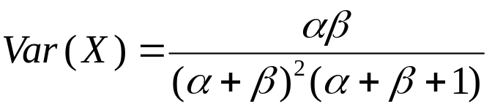
Beta Distribution
Again used in no data situations.
  Bounded on [0,1] interval.
  Can scale to any interval.
  Very flexible shape.

Slide 14
Homogeneous Poisson Process
The number of events happening up to time t is Poisson distributed with rate λt
  The number of events happening in disjoint time intervals are independent
  The time between events are then independent and identically distributed exponential random variables with mean 1/ λ
  Combining two Poisson processes with rates λ and μ gives a Poisson process with rate λ + μ
  Choosing events from a Poisson process with probability p gives a Poisson process with rate p λ
  A homogeneous Poisson process is stationary

Slide 15
Renewal Process
If the time between events are independent and identically distributed then the number of events happening over time are a renewal process.
  The homogeneous Poisson process is a renewal process with exponential inter-event times
  One could also choose the inter-event times to be Weibull distributed or gamma distributed
  Most arrival processes are modeled using renewal processes
  Easy to use as the inter-event times are a random sample from the given distribution
  A renewal process is stationary

Slide 16
Non-stationary Arrival Processes
External events (often arrivals) whose rate varies over time
  Lunchtime at fast-food restaurants
  Rush-hour traffic in cities
  Telephone call centers
  Seasonal demands for a manufactured product
It can be critical to model this nonstationarity for model validity
  Ignoring peaks, valleys can mask important behavior
  Can miss rush hours, etc.
Good model:
  Non-homogeneous Poisson process

Slide 17
Non-stationary Arrival Processes (cont’d.)
Two issues:
  How to specify/estimate the rate function
  How to generate from it properly during the simulation (will be discussed in Chapters 8, 11 …)
Several ways to estimate rate function — we’ll just do the piecewise-constant method
  Divide time frame of simulation into subintervals of time over which you think rate is fairly flat
  Compute observed rate within each subinterval
  Be very careful about time units!
    Model time units = minutes
    Subintervals = half hour (= 30 minutes)
    45 arrivals in the half hour; rate = 45/30 = 1.5 per minute

